Slide 1

Master AAI - Bootcamp Computer Vision basics
Michiel Bontenbal
Donderdag 28 augustus 2025
Acknowledgements: Stijn Oomes

Slide 2
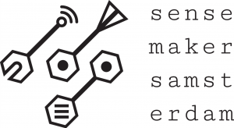
Some questions… raise your hand!
Who has worked with:
Computer Vision
CNN
Numpy
Notes:
Tell I will focus on the basics of installing python / jupyter notebook.

Slide 3
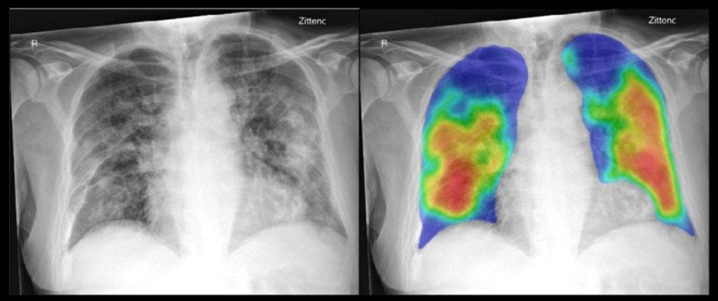
Medisch

Slide 4
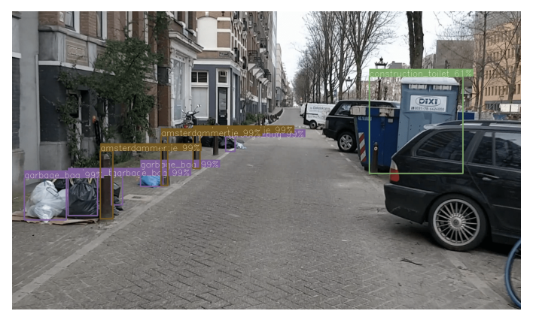
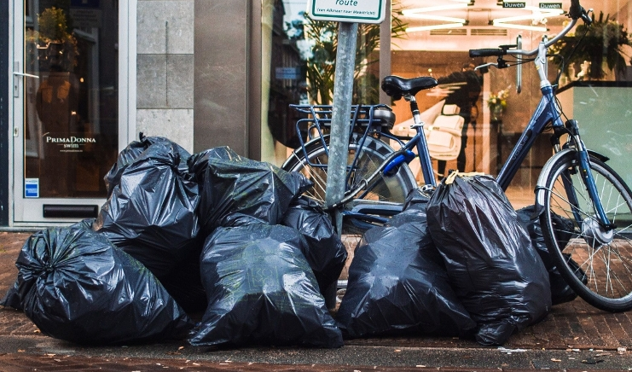
Amsterdam gebruikt actief CV
https://openresearch.amsterdam/nl/page/63153/urban-object-detection-kit-a-system-for-collection-and-analysis-of

Slide 5
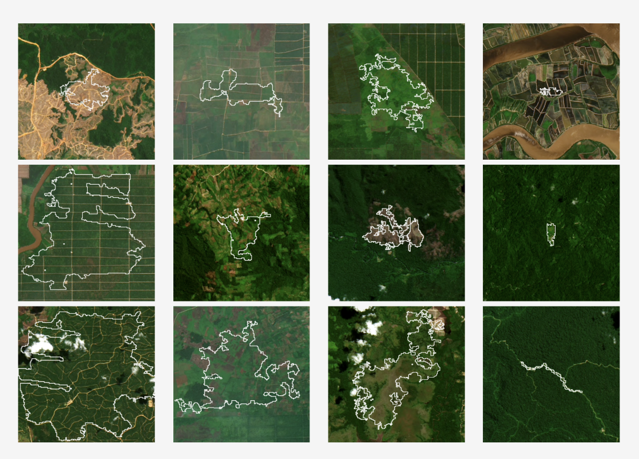
https://stanfordmlgroup.github.io/projects/forestnet/
Deforestation using satellites

Slide 6

What is computer vision?
Computers + camera’s that can “see”
Retrieve information from picture or video
Take an action based on this information

Slide 7
Je gebruikt computer vision al elke dag
Wat kun je met de computer vision in je telefoon?
Selfie door hand opsteken
Gezichtsdetectie
Filters voor achtergrond blurren
QR codes
Stickers maken met je foto’s
…
minor AAI - Bootcamp - Dag 4

Slide 8
Computer Vision en AI
Artificial Intelligence
Computer Vision
Machine Learning
Deep Learning
These lessons are about Computer Vision
using Deep Learning

Slide 9
Computer Vision
1e uur
Theorie: Digitale foto’s + filters
Notebook filters
2e uur:
Theorie: Convolutionele Neurale Netwerken
Notebook CNN maken
3e uur:
Faces herkennen:
Notebook
minor AAI - Bootcamp - Dag 4

Slide 10
Tijdslijn Computer Vision (CV)
Numpy
ResNet
ViT = Vision
Transformer
Vision
Language Models
Start CV
1966
2005
2015
2023
2000
2012
2021
2016
OpenCV
Convolutional Neural Net
YOLO
Object Detectie
Text-Image pairs
CLIP
Foundation
Models

Slide 11
Ditigale foto’s

Slide 12
Hoe ‘werkt’ een digitale foto?
Wat zien mensen, wat ‘zien’ computers?
Wat is het ‘elektromagnetische spectrum’?
Waarom zijn digitale foto’s eigenlijk ‘R,G,B’?
minor AAI - Bootcamp - Dag 4

Slide 13
Wij zien plaatjes, computers ‘zien’ cijfers
minor AAI - Bootcamp - Dag 9

Slide 14
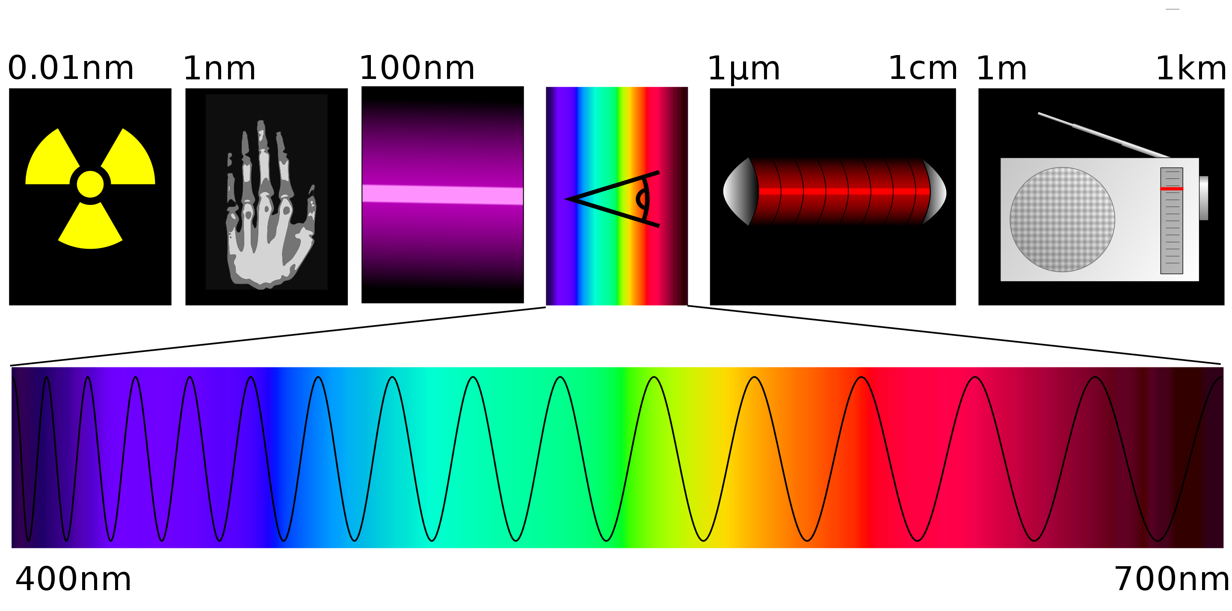
Elektromagnetische straling: onze ogen zien maar een klein deel van spectrum.
https://nl.wikipedia.org/wiki/Elektromagnetische_straling
Notes:
Gammastraling, rontgen, UV, Zichtbbaar licht, infrarood, radiogolven

Slide 15
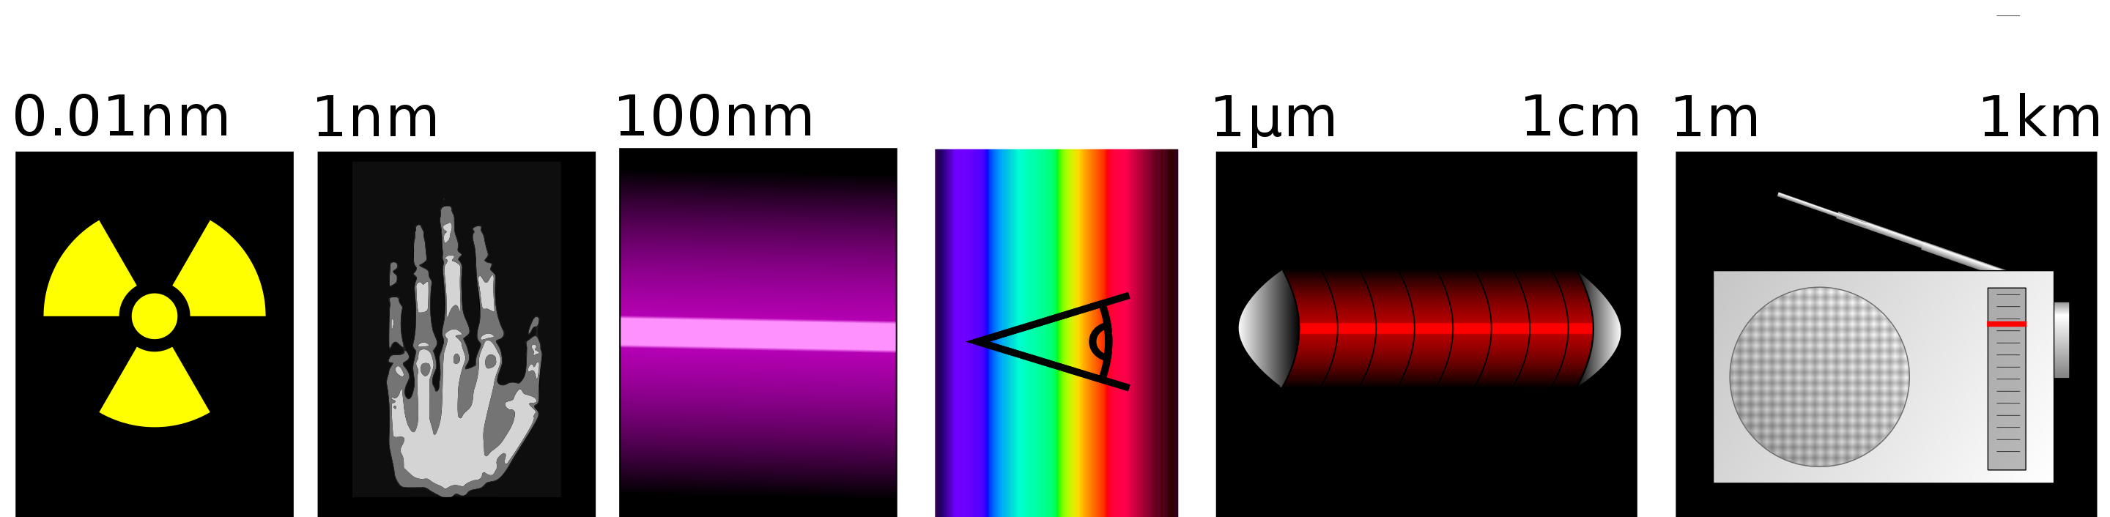
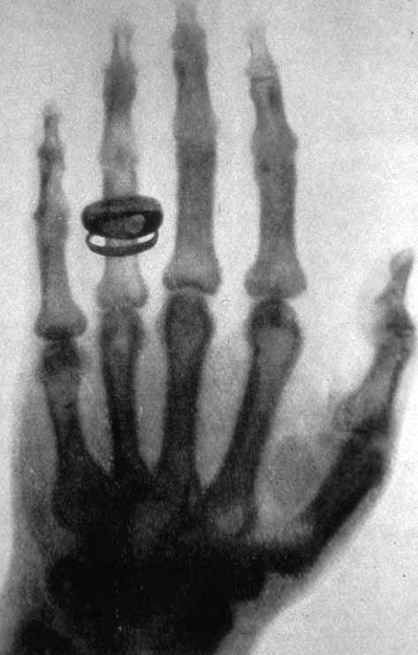
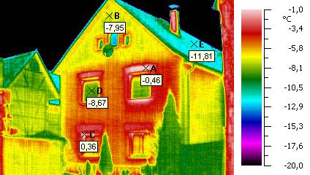
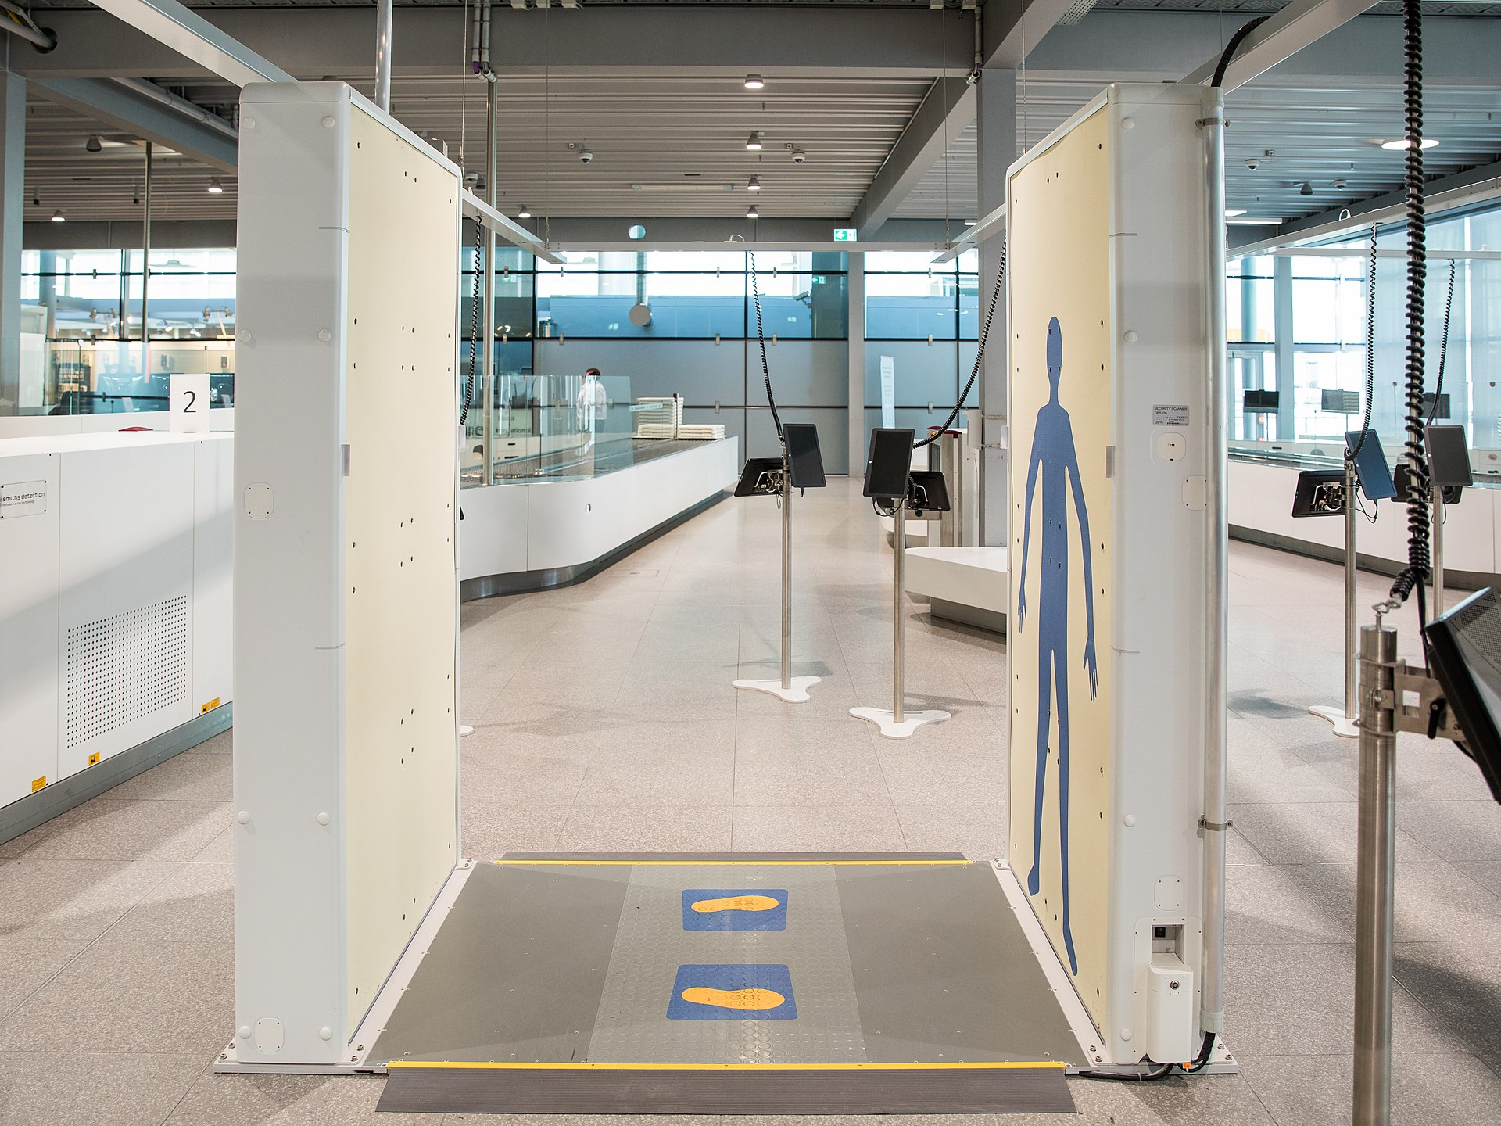
Camera’s buiten het zichtbare licht

Slide 16
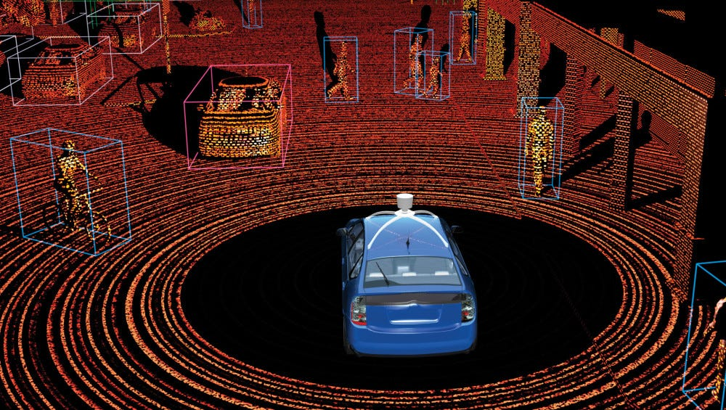
Lidar en point clouds
Lidar = LIght Detection And Ranging.
Lidar registreert reflectie
Elk punt (X, Y, Z) coordinaten.
Je kan een AI-model trainen om objecten te herkennen

Slide 17
Digitale foto R,G,B
minor AAI - Bootcamp - Dag 4

Slide 18
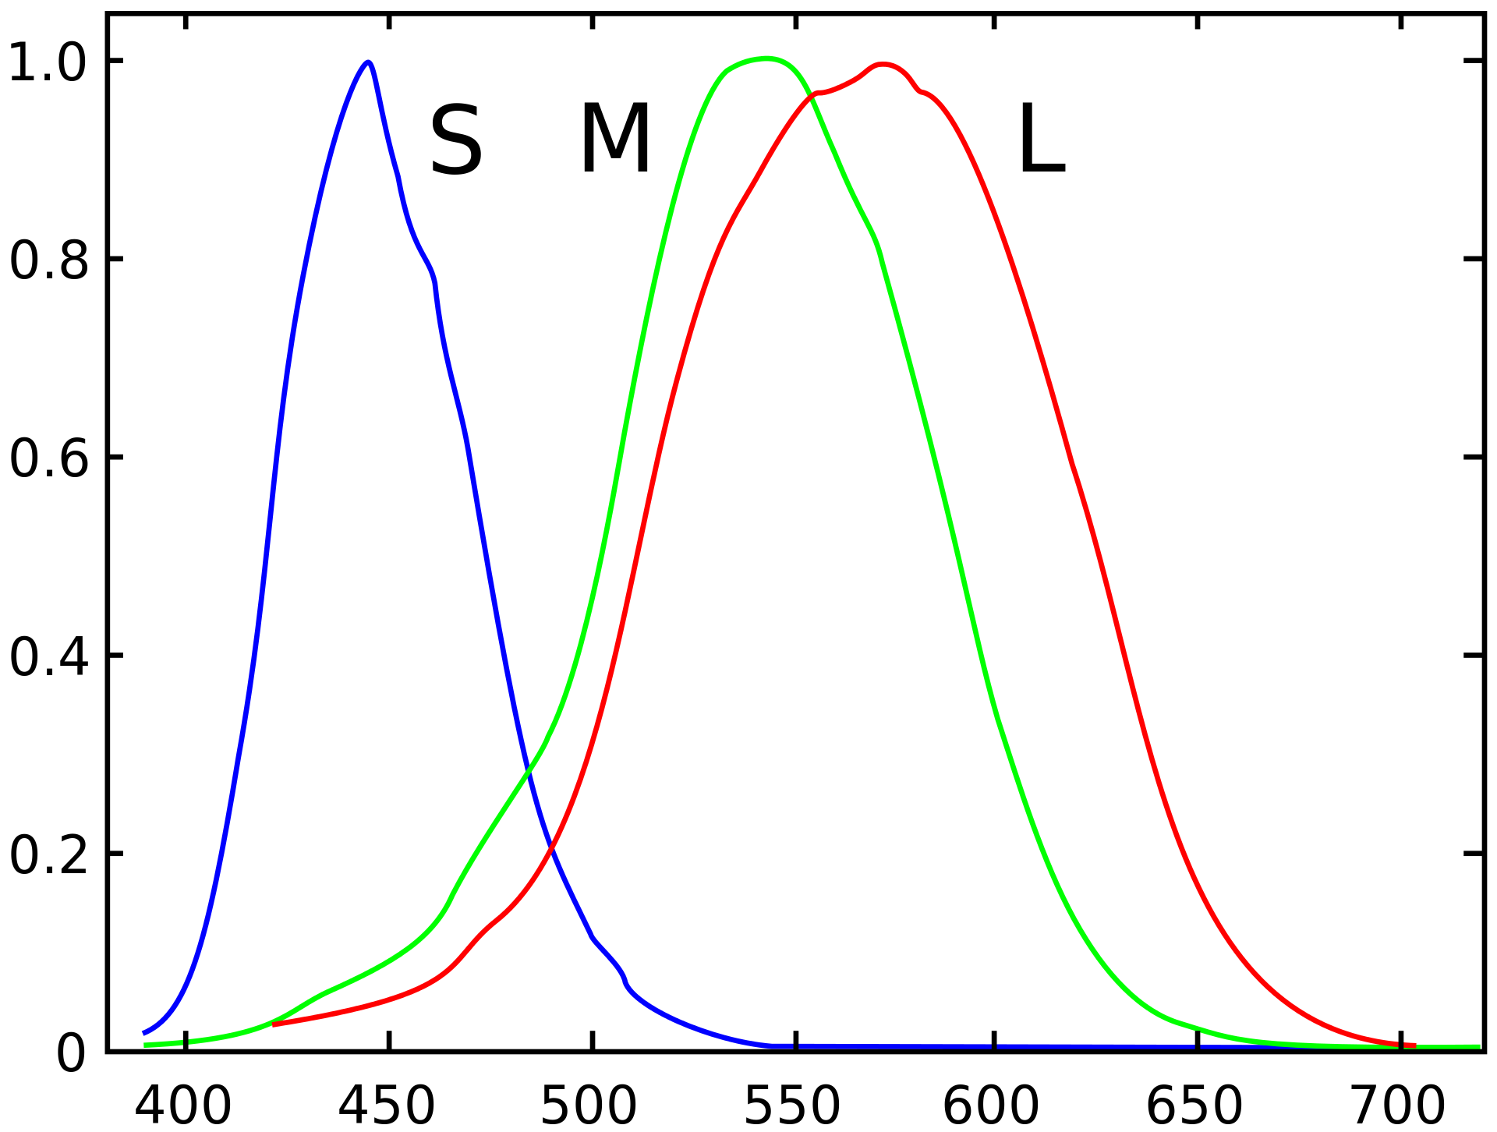
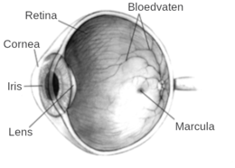
Mensen nemen vooral R,G,B waar. Andere kleuren minder.
Mensen zijn ‘tri-chromatisch’. Tri = drie en chroma = kleur
Netvlies (of retina) vangt vooral drie kleuren op: RGB
https://en.wikipedia.org/wiki/Trichromacy

Slide 19
Samenvattend: digitale foto’s zijn RGB omdat die kleuren door ons het best gezien worden.
Let op: circa 3% van de mensen is kleurenblind en ziet niet alle kleuren!

Slide 20

NumPy

Slide 21
NumPy is een Python library
Numerical Python
Wiskundige library vooral voor arrays en matrices
documentatie : https://numpy.org
import numpy as np
minor AAI - Bootcamp - Dag 4

Slide 22
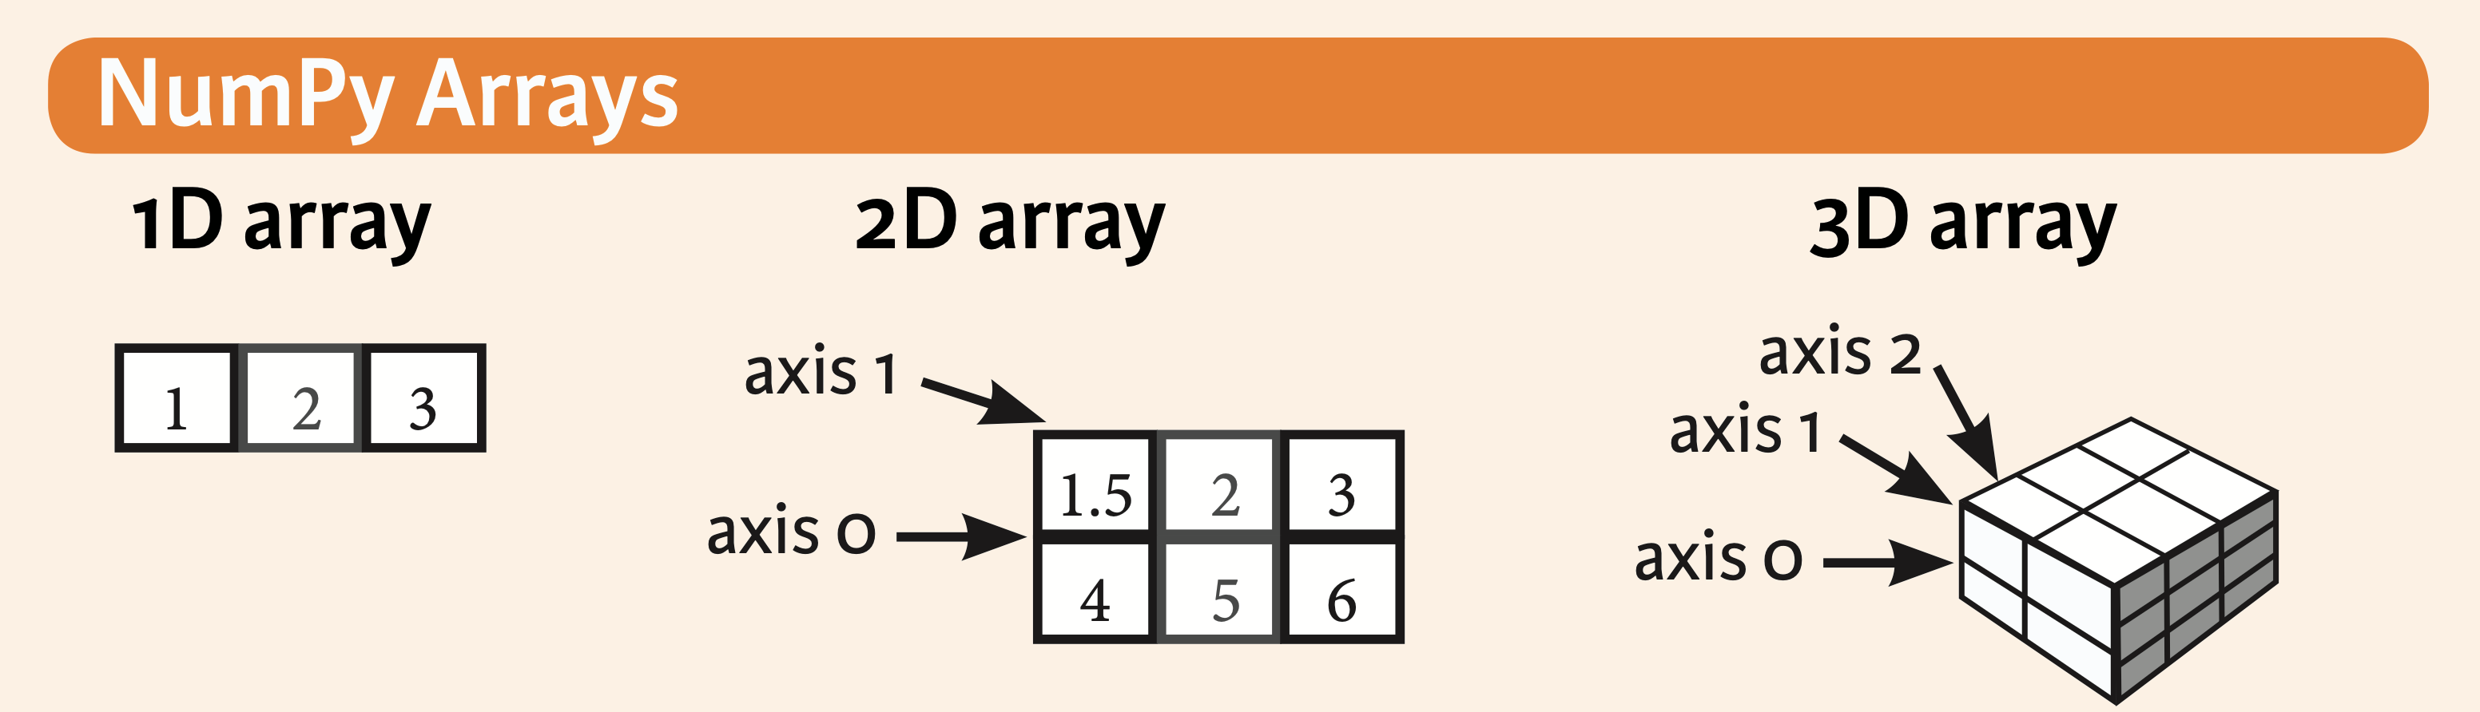
NumPy array
minor AAI - Bootcamp - Dag 4

Slide 23
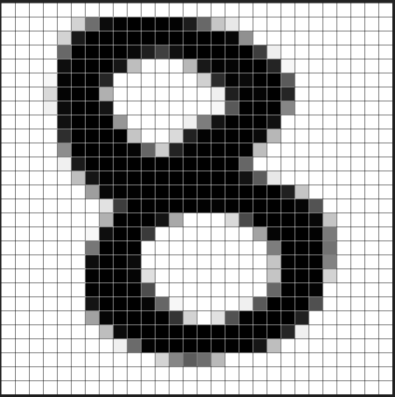
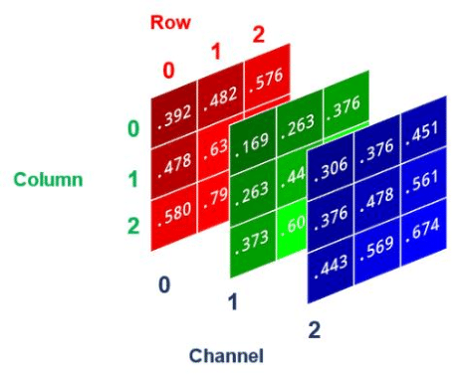
Een image is ook een array.
Hoeveel dimensies heeft het linker plaatje?
En het rechter?
Hoogte, Breedte en Diepte (1)
Hoogte, Breedte en Diepte (3x)
minor AAI - Bootcamp - Dag 4

Slide 24
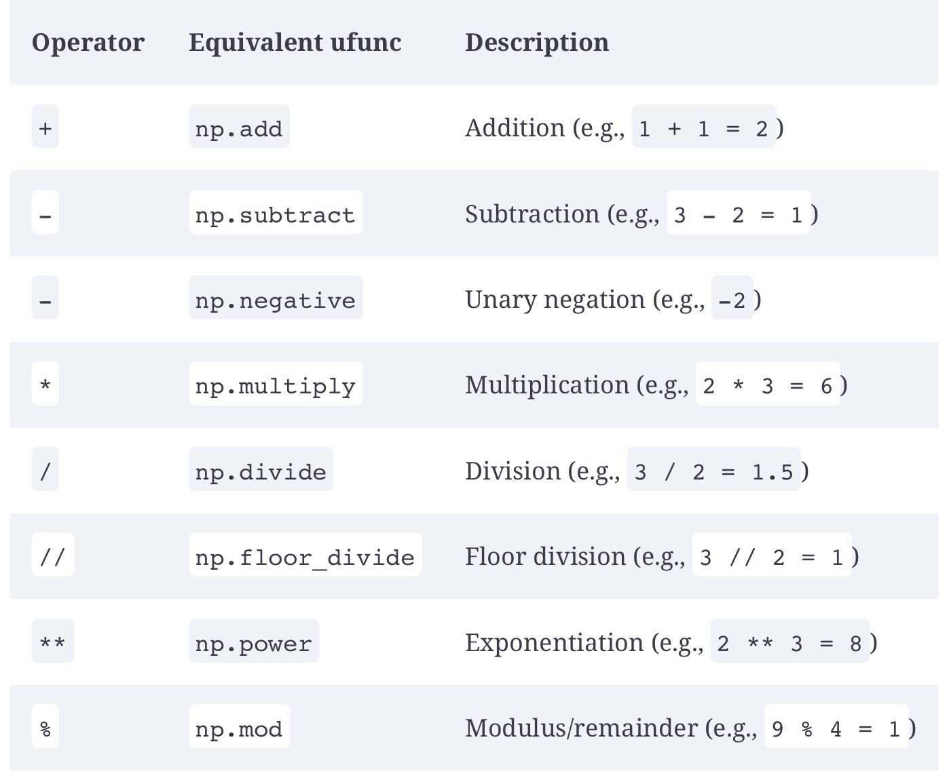
Numpy = wiskunde
minor AAI - Bootcamp - Dag 4

Slide 25
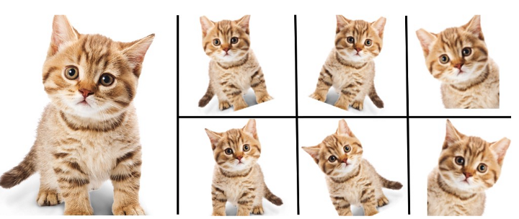
Vergroot je dataset met data augmentation
To do

Slide 26
Data augmentation - praktisch
Numpy
np.flipud, np.fliplr, np.rot(45)
Keras
ImageDataGenerator()
Torchvision (PyTorch)
torchvision.transforms()
https://analyticsindiamag.com/image-data-augmentation-impacts-performance-of-image-classification-with-codes

Slide 27
Handbook
Ch. 2 Intro to NumPy
https://learning.oreilly.com/library/view/python-data-science/9781491912126/
https://lib.hva.nl/discovery/dbfulldisplay?context=L&vid=31UKB_UAM2_INST:HVA&docid=alma9939149327405132
minor AAI - Bootcamp - Dag 4

Slide 28
Notebook
Numpy for images.ipynb
minor AAI - Bootcamp - Dag 4

Slide 29
Convoluties en kernels

Slide 30
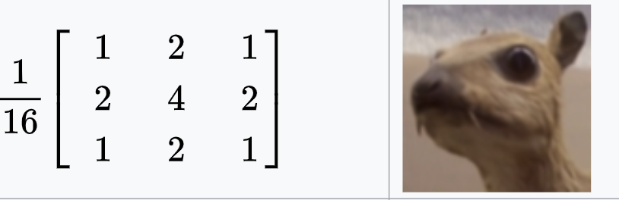
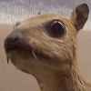
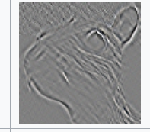
Image manipulation

Slide 31
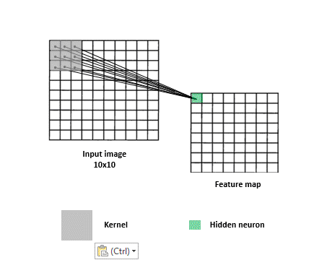
Kernel operation
A kernel (aka filter) is a matrix of 3x3 or 5x5 cells
In the kernel operation you go over the input image and do a calculation
This results in a new matrix (‘feature map’) that is the resulting image.

Slide 32
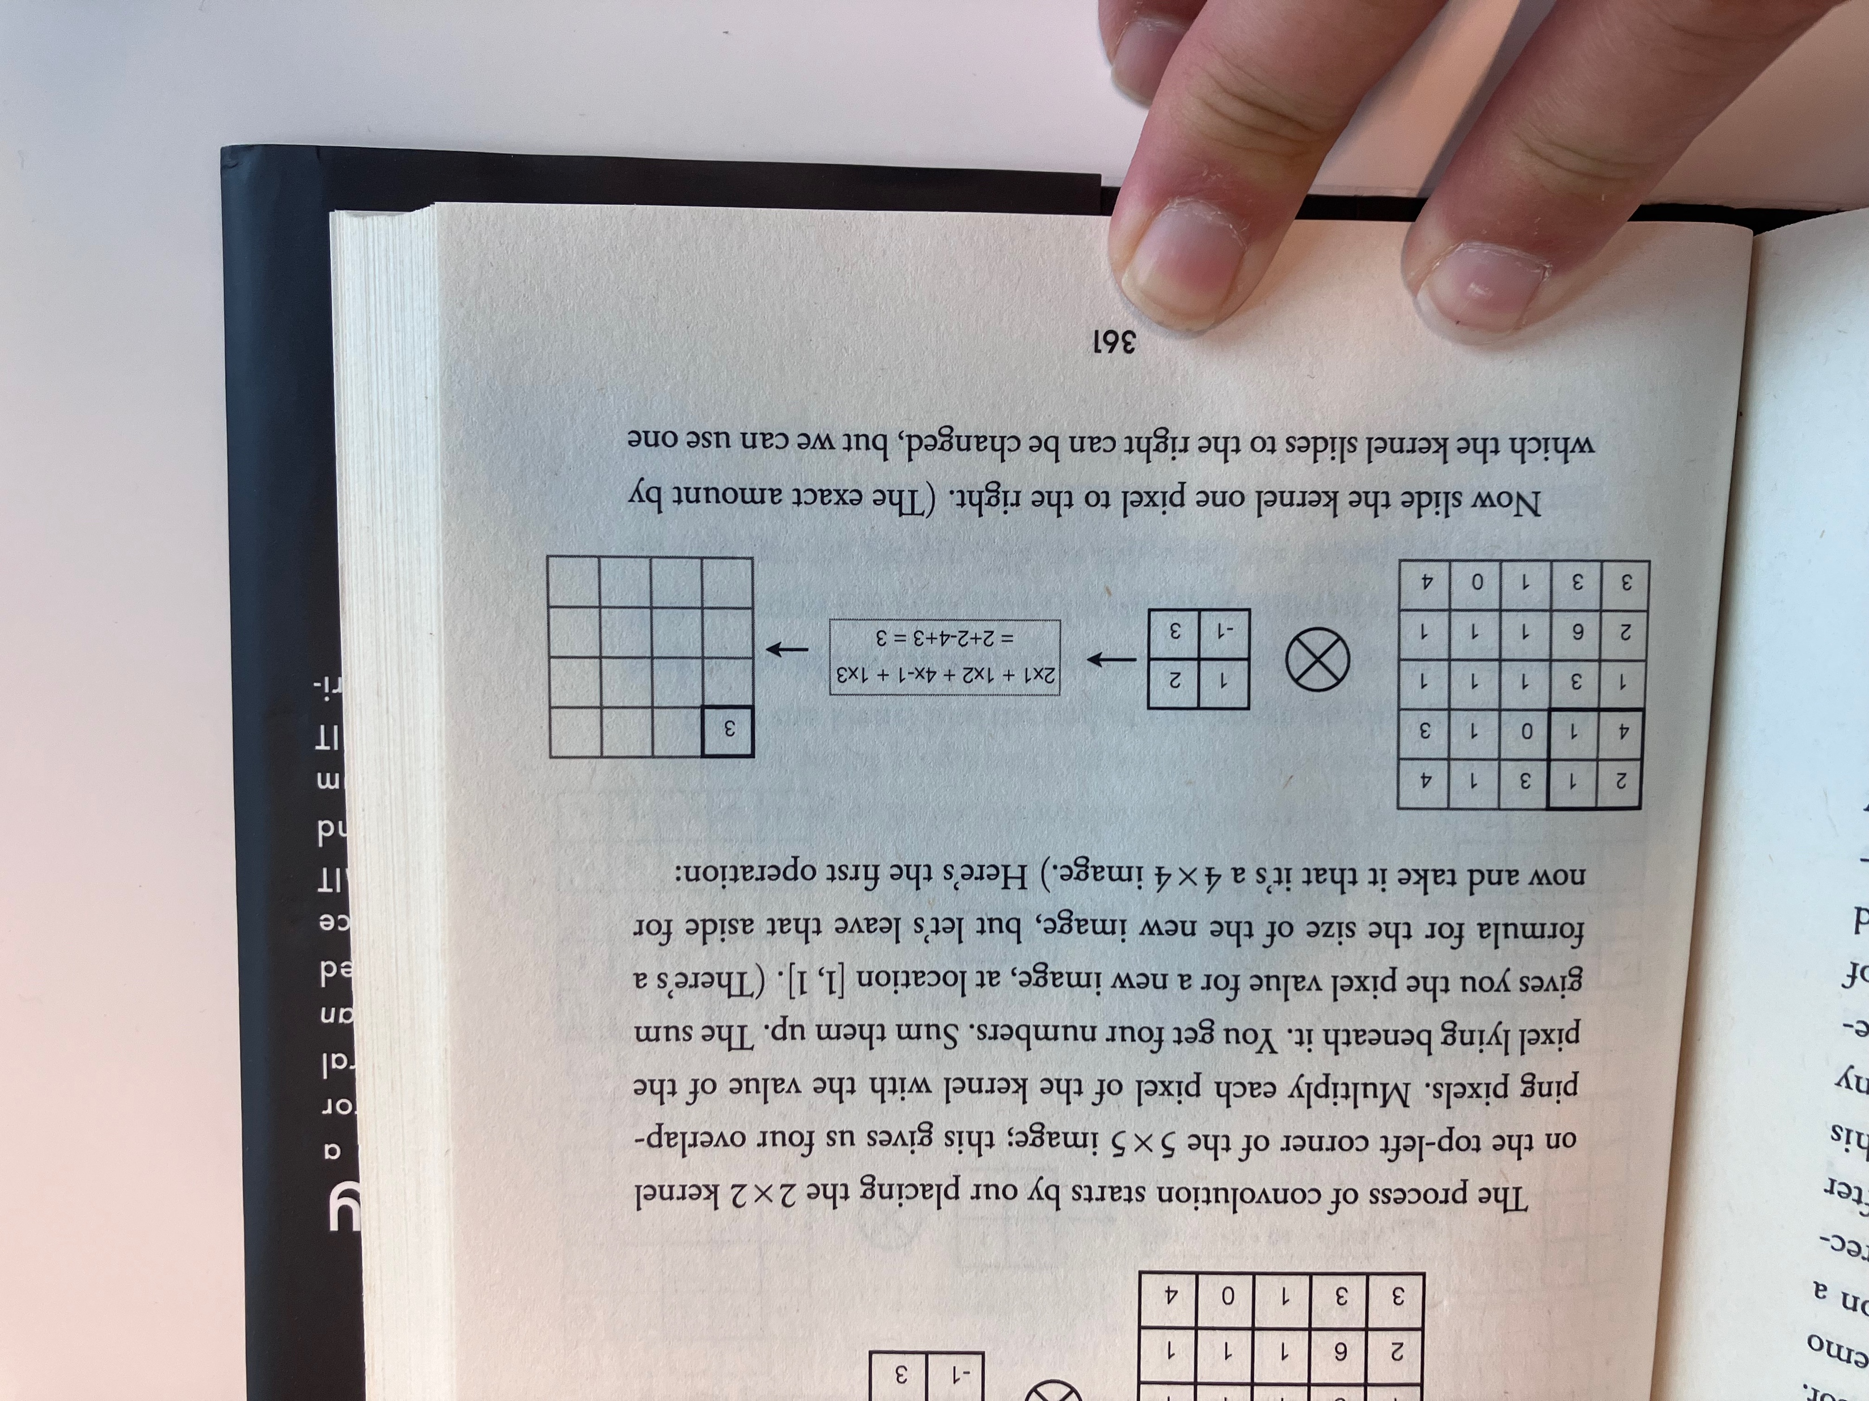
Example kernel calculation

Slide 33
Using a kernel
Examples:
Blurring: Smooths out noise and details in an image
Sharpening: Enhances edges and fine details
Edge detection: Identifies boundaries of objects in an image
Embossing: Creates a 3D-like effect
Gaussian blur
Source: https://en.wikipedia.org/wiki/Kernel_(image_processing)

Slide 34
AI coding exercise
Opdracht: Genereer code met een AI die de wiskundige berekening laat zien in numpy.
Soure: Why machines learn – Anil Ananthaswany

Slide 35
Notebook
Kernel_from_scratch.ipynb

Slide 36
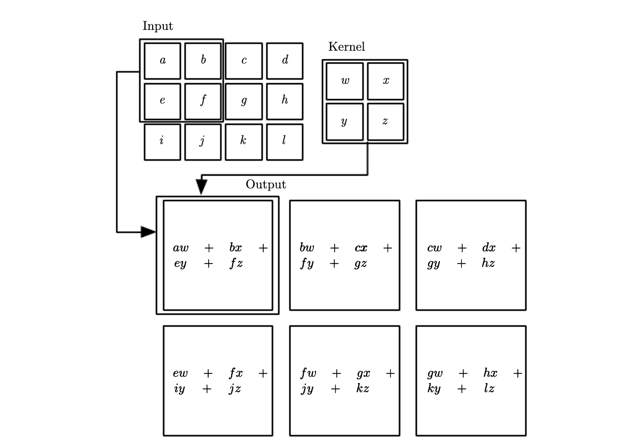
Kernel operation theory summary
Kernel size 3x3 or 5x5
Stride: steps you take with kernel. Eg. Stride = 2 you go 2 steps to the right/down.
Padding: a trick where you add extra cells to input imagee.
Source: https://www.deeplearningbook.org/contents/convnets.html

Slide 37
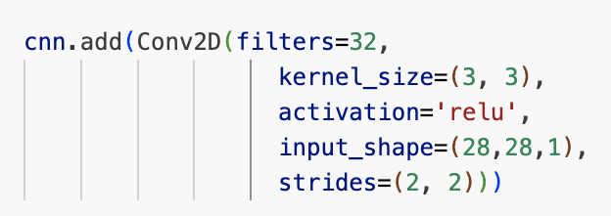
Students should understand AI at 3 levels: Concept and math and code
Example: kernel operation in a Conv2D layer
f(x) ∗ g(x)
(∗ convolution operator)
Concept
Math
Code

Slide 38
Recap neural net

Slide 39
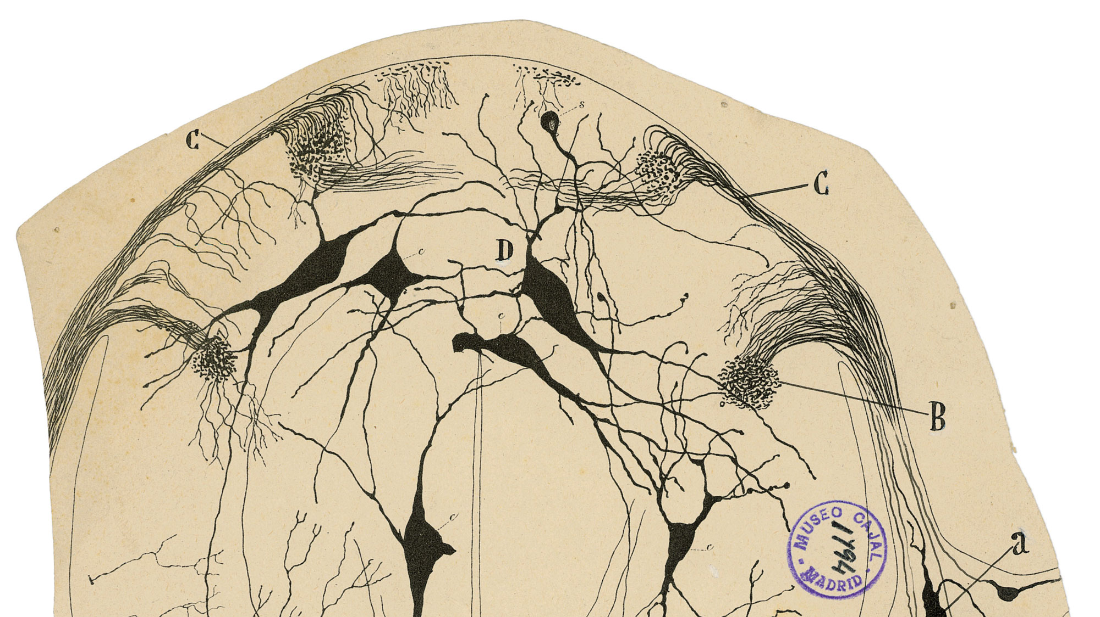
Santiago Ramón y Cajal
Nobel Prize Physiology 1906

Slide 40
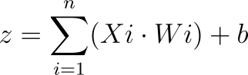

From human neurons to artificial neurons
$$∑$$
f
Summation
Activation function

Slide 41
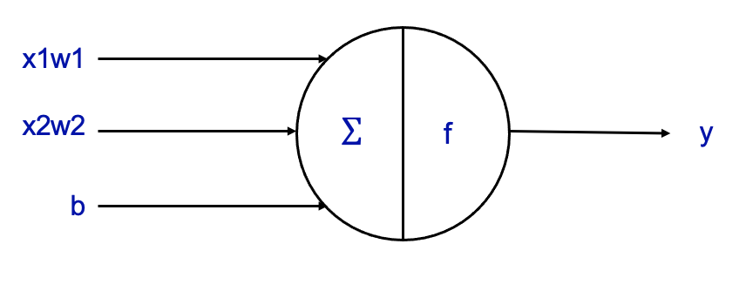
Neurons do calculations (1)
Inputs (x)
These are the input values to the neuron.
Weights (w)
Each input is associated with a weight, which determines the strength of that input.
Bias (b)
A constant
Summation (Σ):
Sum of inputs x weights + bias
Sum=(x1​×w1​)+(x2​×w2​) + b

Slide 42

Neurons do calculations (2)
Activation Function:
The summed value is passed through an activation function to produce the output (y).
In the example a basic activation function: ReLu
if x <= 0:
y = 0
else:
y = x

Slide 43
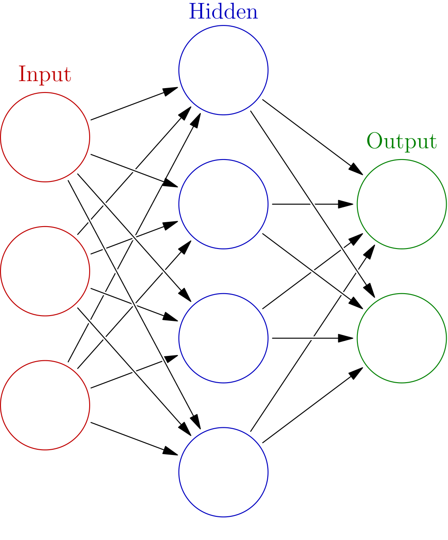
From one neuron to a neural net
Input layer
Hidden layer
Output layer
Each arrow = input * weight + bias
‘Dense layer’.

Slide 44
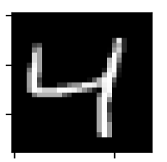
A CNN uses supervised learning
Labeled data
Prediction
Ground truth
input

Slide 45
Deep learning flow
Learning = finding optimal weights
Input X
Layer
Weights
Layer
Weights
Label
Predictions Y’
True target Y
Optimise weights
Loss function
‘Backpropa-gation’
Loss score
Source: Deep Learning with Python

Slide 46
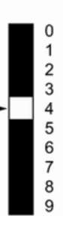
Deep learning flow
Learning = finding optimal weights
Layer
Weights
Layer
Weights
Label
Predictions Y’
for each class
True target Y
Optimse weights
Loss function
‘Backpropagation’
Loss score
Source: Deep Learning with Python

Slide 47
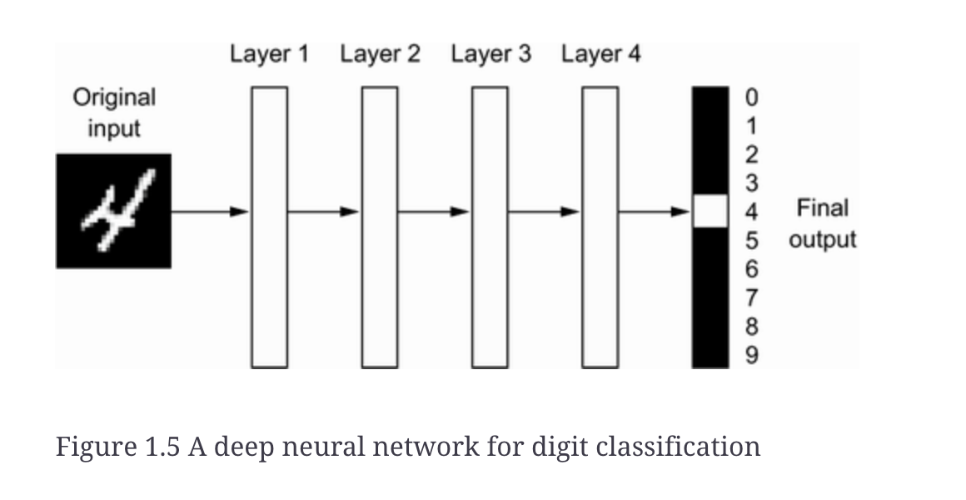
What is the ‘deep’ in deep learning?
Source: Deep Learning with Python, Francois Chollet, 1.1.4 The ‘deep’ in deep learning

Slide 48
Convolutional
Neural
Netwerks

Slide 49
Convolutional Neural Network (CNN)
What is a convolution?
What’s the difference with ‘normal’ Neural Nets?
What are the layers in a CNN?
How can a CNN learn?
minor AAI - Bootcamp - Dag 9

Slide 50
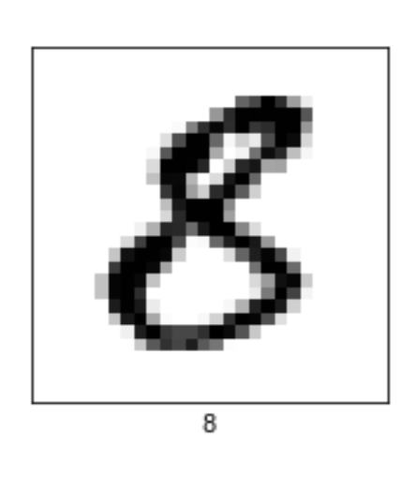

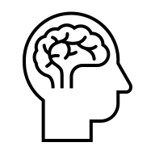
How do we as humans recognize this?
8

Slide 51
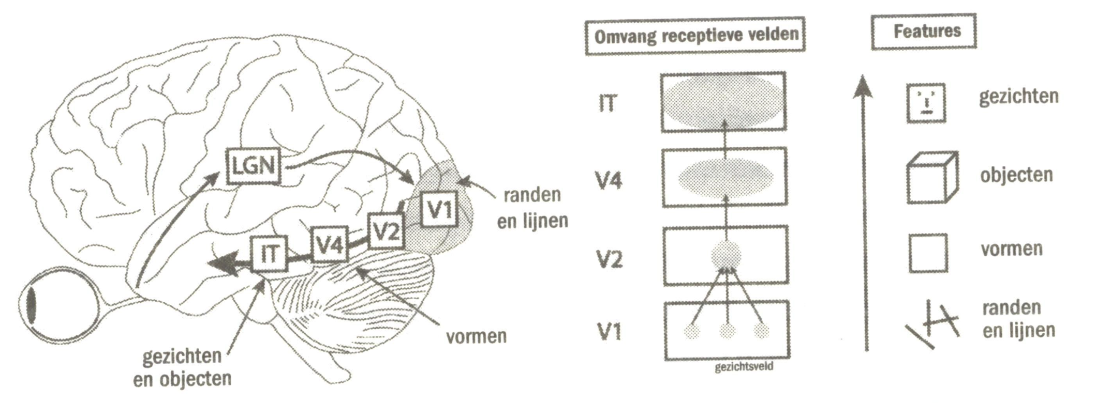
How we see and recognise things (Hubel & Wiesel 1959, Nobel prize ‘81)
Source: A Brief history of Intelligence - Max Bennett
Notes:
David Hubel and Torsten Wiesel – 1959 – John Hopkins University – Working with cats.
Two discoveries by them:
Mammals have hierarchical vision – from small edges/lines to more complex objects like faces
Different areas in the back of your back
Resulting in FEATURE MAPS
Inspired Kunihiko Fukushima to do this with computers
Yann LeCunn is credited with with getting this to work.

Slide 52
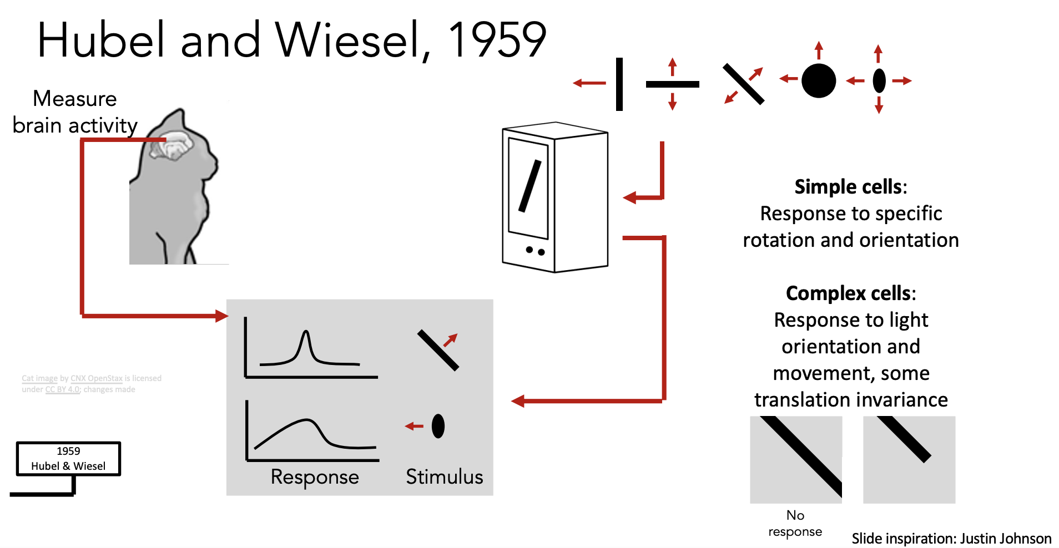
In our brains we have specialized cells to do ‘vision’: simple and complex cells.

Slide 53
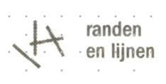
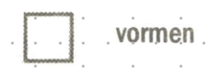

How a CNN works
Neural net
for classification
Recognise Features

Slide 54
Convolution2D Layer
minor AAI - Bootcamp - Dag 9

Slide 55
Conv2D layer (2/2)
minor AAI - Bootcamp - Dag 9

Slide 56

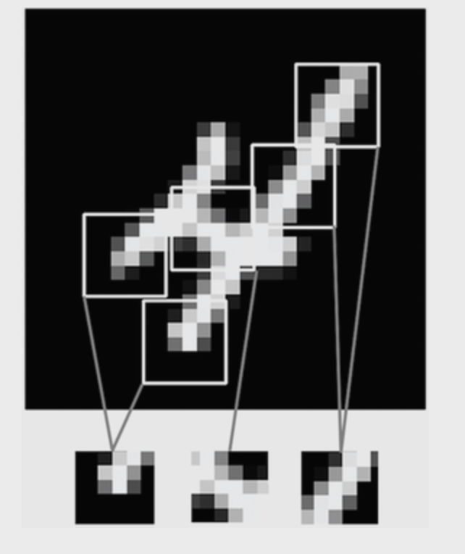
1st conv layer recognises edges and lines
Source: Deep Learning with Python, Francois Chollet, 8.1 Intro to Convnets

Slide 57
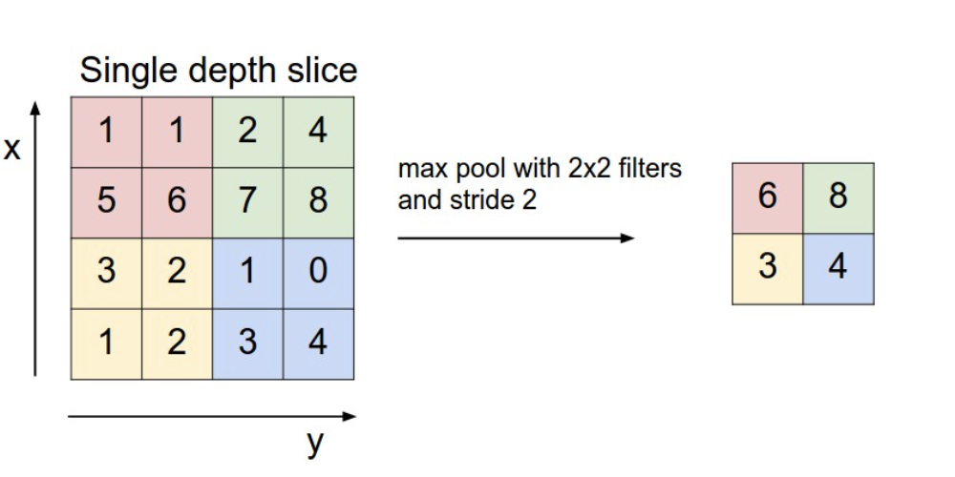
Pooling layer max pooling, average pooling
Source: https://cs231n.github.io/

Slide 58
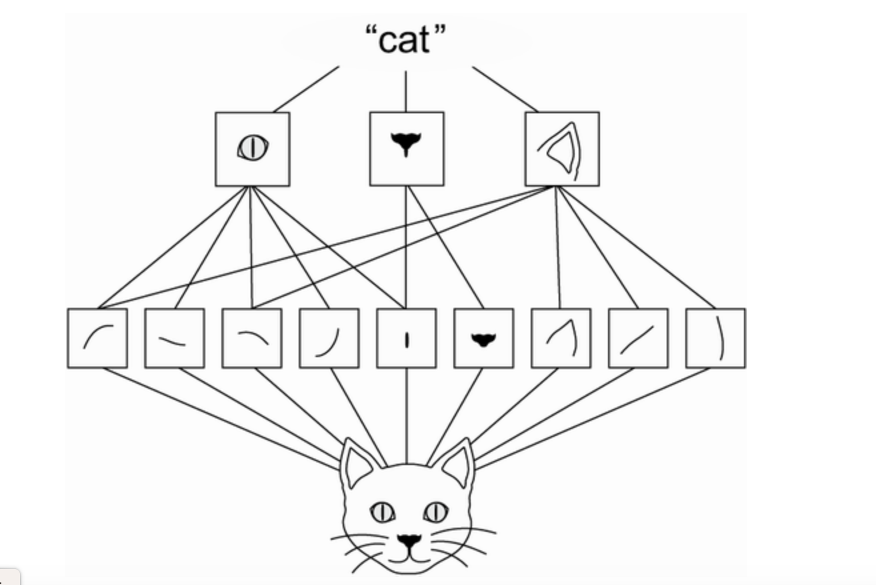
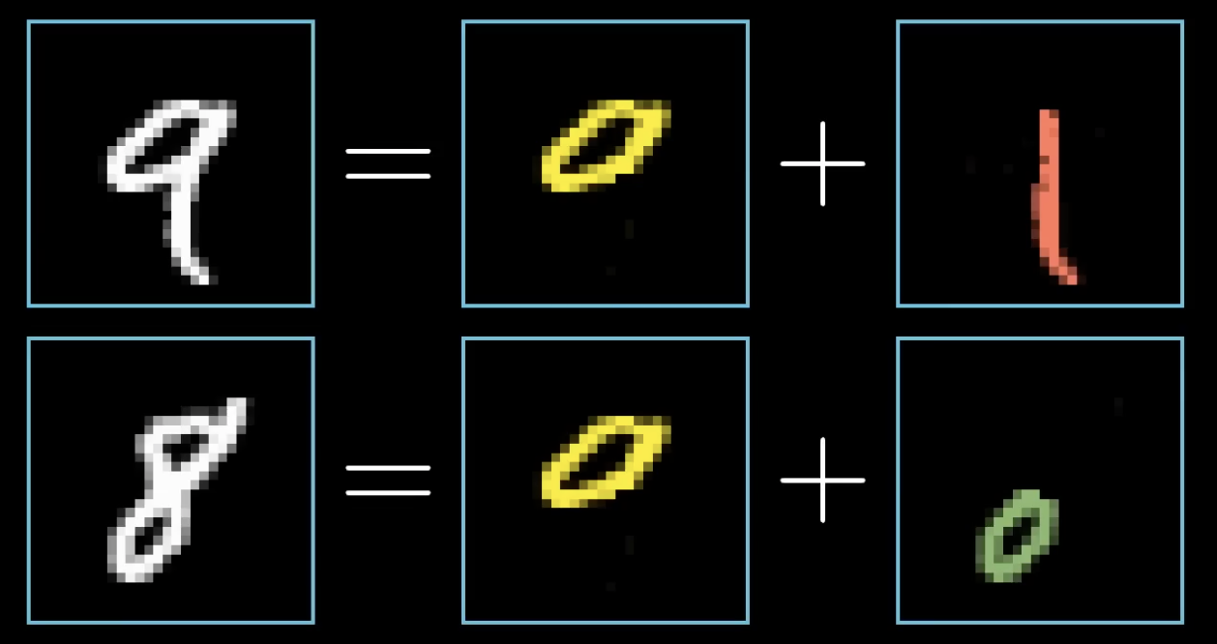
By repeating conv2d + pooling, the model can recognize larger features
Source: Deep Learning with Python, Francois Chollet, 8.1 Intro to Convnets

Slide 59
Flatten(): 2D image => 1D input layer
“flatten()”
Convert 1 pixel => 1 node of input layer.
For MNIST 28 x 28 = 784 node
minor AAI - Bootcamp - Dag 9

Slide 60

Dense of Fully Connected Layer
Elke cel met volgende laag vervonden.

Slide 61
Convolutional Neural Network
minor AAI - Bootcamp - Dag 9

Slide 62
The kernel & backpropagation
Input image
Kernel
5 | 3 | 2 | 1 | 0
1 | 1 | 3 | 1 | 2
2 | 2 | 2 | 0 | 5
4 | 3 | 1 | 4 | 4
5 | 5 | 0 | 1 | 3
? | ? | ?
? | ? | ?
? | ? | ?
Weights

Slide 63
Python libraries for neural nets
High-level
Keras
Pytorch
Low-level
Tensor-
flow
Torch
JAX
CPU
GPU
TPU
Hardware

Slide 64
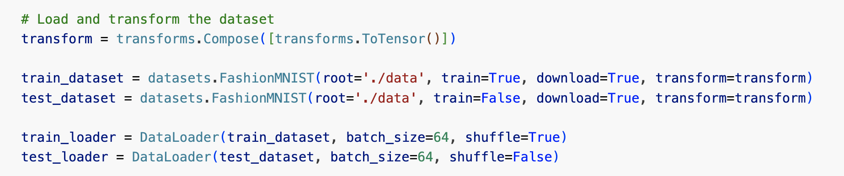
Pytorch code reading: load data
A PyTorch DataLoader efficiently loads data in mini-batches from a dataset, with options for shuffling, parallel loading, and automatic batching.
Notes:
Hyper = Grieks voor over, boven
Hyperparams zijn de settings die boven het model staan.
Hyperparameters are the configurations that are external to the model and whose values cannot be estimated from data.
Deze hyperparameters hangen af van de taak.
De gekozen hyperparameters hier zijn dus goed voor classificatie van images.
Adam = (Adaptive Moment Estimation) . Ontwikkeld hier in Amsterdam.
Voor classificatie gebruiken we meestal een cross_entropy, voor regressie een Mean Square Error.

Slide 65
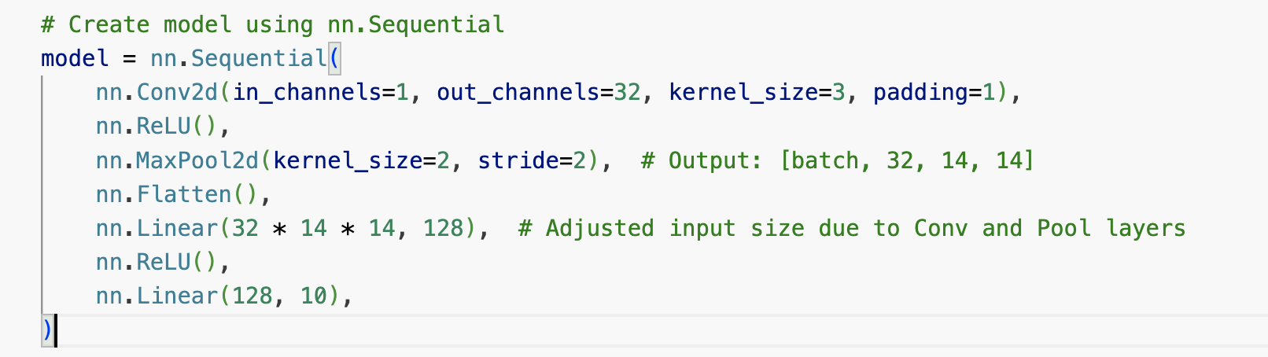
Pytorch code reading: create model
Zie www.keras.io/api
Notes:
Hyper = Grieks voor over, boven
Hyperparams zijn de settings die boven het model staan.
Hyperparameters are the configurations that are external to the model and whose values cannot be estimated from data.
Deze hyperparameters hangen af van de taak.
De gekozen hyperparameters hier zijn dus goed voor classificatie van images.
Adam = (Adaptive Moment Estimation) . Ontwikkeld hier in Amsterdam.
Voor classificatie gebruiken we meestal een cross_entropy, voor regressie een Mean Square Error.

Slide 66
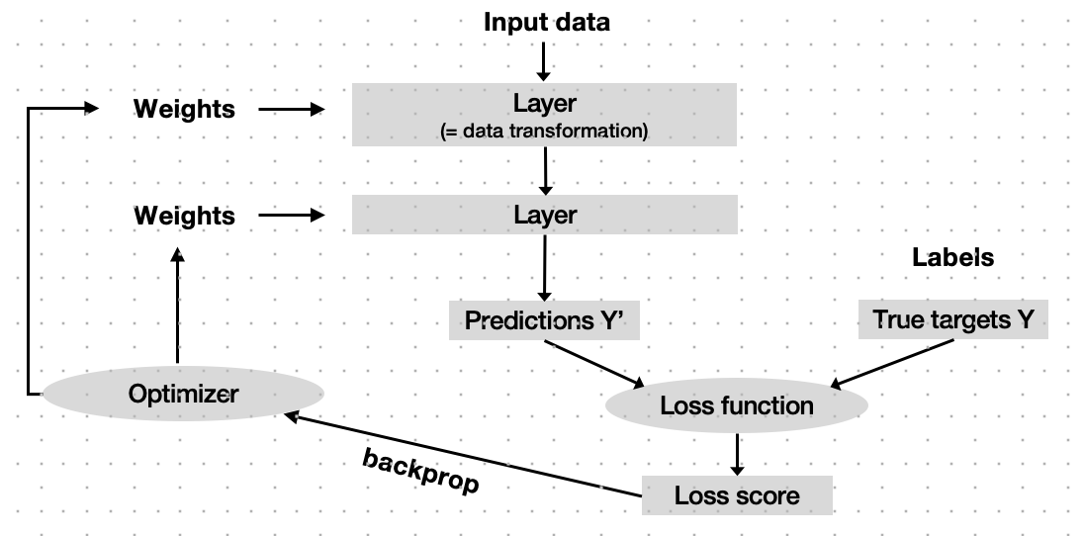
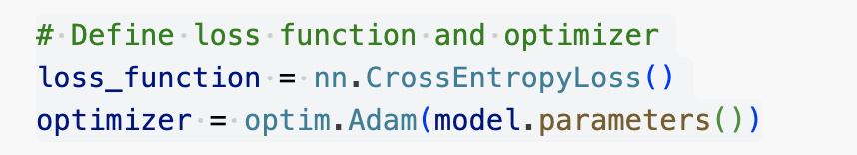
Pytorch code reading
Notes:
Hyper = Grieks voor over, boven
Hyperparams zijn de settings die boven het model staan.
Hyperparameters are the configurations that are external to the model and whose values cannot be estimated from data.
Deze hyperparameters hangen af van de taak.
De gekozen hyperparameters hier zijn dus goed voor classificatie van images.
Adam = (Adaptive Moment Estimation) . Ontwikkeld hier in Amsterdam.
Voor classificatie gebruiken we meestal een cross_entropy, voor regressie een Mean Square Error.

Slide 67
Summary CNN
What is a “convolution”?
A ‘convolution kernel’ is a matrix that goes step-by-step over the image
What is difference with ‘normal’ NN’s?
Conv2D + Pooling Layers
minor AAI - Bootcamp - Dag 9

Slide 68
Summary CNN
What are the layers of a CNN?
Conv2D, Pooling, Flatten, Linear
Summary: how can a CNN ‘learn’
from small features to larger, more complex features

Slide 69
Notebook CNN
Fashion_mnist_with_Pytorch.ipynb
minor AAI - Bootcamp - Dag 9

Slide 70
Installeer python 3.12
Visit the official Python website (www.python.org/downloads/)[1].
Download 3.12 & installer
Herstart VS Code
Selecteer kernel in VS Coce
GETEST OP MACOS

Slide 71
NN ca. 0.94
CNN > 0.99
World record: 0.9983
Name | Score CNN

Slide 72
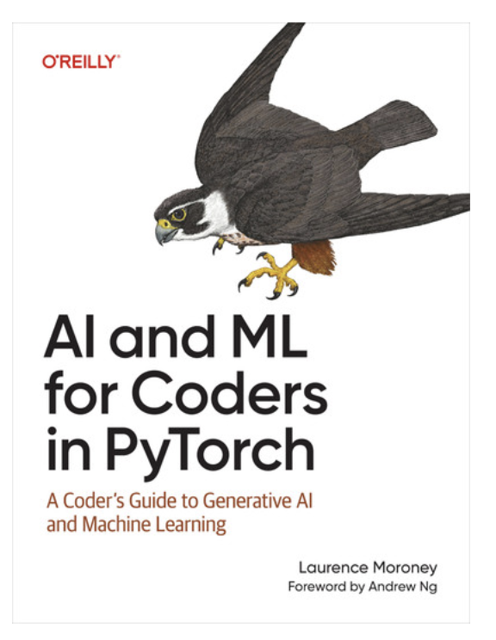
Read & view more
Book
Laurence Moroney: "AI and ML for Coders in PyTorch”
https://learning-oreilly-com.rps.hva.nl/library/view/ai-and-ml/9781098199166/
Other book
‘Deep learning with python’ – Francois Chollet
https://learning-oreilly-com.rps.hva.nl/library/view/deep-learning-with/9781617296864/
Neural network in 60 seconds - Youtube
https://www.youtube.com/shorts/LCE3LY-iSac
But what is a neural network? Youtube
https://www.youtube.com/watch?v=aircAruvnKk&

Slide 73
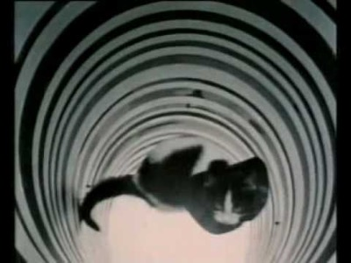
Bonus: Can cats see lines from birth? Or do they develop their vision by ‘training’ their brain?
https://youtu.be/QzkMo45pcUo?t=198

